Slide 1
Sanitary Engineering
Sewerage Engineering
Primary Treatment System
By
Dr. Muhanad M. Abbas

Slide 2
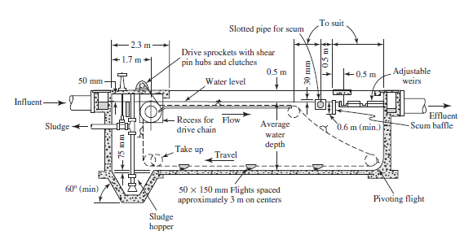

Slide 3
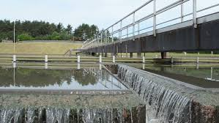

Slide 4
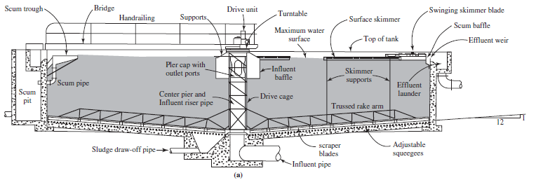

Slide 5
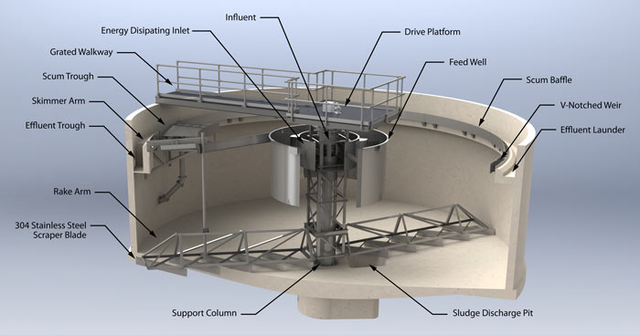

Slide 6
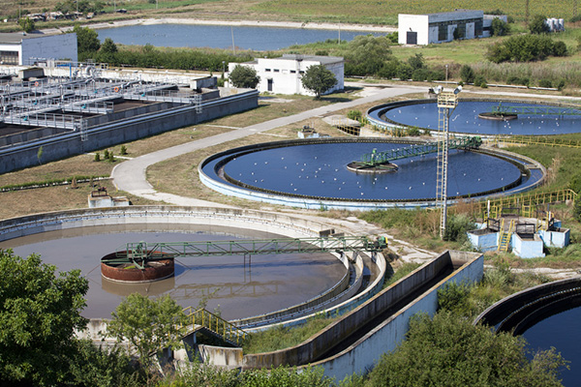

Slide 7
Some design condition of :
Rectangular tank: length /width = 4/1
Minimum depth 2 to 6m average 3.5m (12 ft )
Weir loading rate =120 to 370 m³/d per meter of weir length (10,000 to 30,000 gall/ft per day )
Velocity of sludge and scum : 1m/min (3ft/min )
Circular tank = depth 2 to 4m (6 to 13ft)
Weir loading rate : same above
Sludge and scum =1.5 to 2.5 m/min (5 to 8ft )minim.

Slide 8
(A)
For the mixture of hospital waste with river water K₁@ 20 Cº 0.1/day, mixture temperature 24 Cº and BOD at time zero 15 ppm, Find required time for BOD 10.48 ppm.
(B)
For the mixture of hospital waste with river water K₁@ 20 Cº 0.1/day, mixture temperature 22 Cº and BOD at time zero 17 ppm, Find required time for BOD remaining 7.05 ppm

Slide 9
(A)
For the mixture of hospital waste with river water K₁@ 20 Cº 0.1/day, BOD₁₀ 10.48 ppm and BOD at time zero 15 ppm, Find mixture temperature?
(B)
For the mixture of hospital waste with river water K₁@ 20 Cº 0.1/day, BOD remaining 7.05 ppm after 8 days and BOD at time zero 17 ppm, Find mixture temperature?

